Slide 1

Information pack
Commercially Sensitive

Slide 2
COSAIN© is the market leading social media listening and research platform. COSAIN© is a suite of 6 bespoke software tools to assist i3 and OSINT investigators, researchers, and analysts to quickly access open source, social media, and consented data, ensuring efficiency. ​
​
COSAIN© was developed in close collaboration with expert UK law enforcement clients and is delivered to users as a secure SaaS solution, with email 2FA, and MIA compatibility.​ There is no requirement for specialist IT equipment or software to download.
​
COSAIN© is ISO27001, Cyber Essentials Plus, GDPR and DPA compliant, and all COSAIN© data is hosted and processed in the UK.
​Every COSAIN© client has a dedicated client relationship manager who is an OSINT SME and SC cleared, and we provide 24/7/365 phone and email support.​
What is COSAIN?

Slide 3






COSAIN Functionality
3 main themes spread over the 6 tools
Social Media Listening Platform using the major social media sources.
There is a full audit capability on every aspect of COSAIN© functionality, for organisational risk mitigation
Audit functionality
Historic data research tools
OSINT
tools
There is a full audit capability on every aspect of COSAIN© functionality, for organisational risk mitigation

Slide 4





Operational Effectiveness
1 Licence
COSAIN© never stops searching, 24 hours a day, 7 days a week, 365 days a year
1 Licence
COSAIN© can provide a capability across all business areas
1 Licence
COSAIN© searches against hundreds of millions of posts daily
1 Licence
COSAIN© reduces the % of time staff spend on research, and increases analysis time
Strategic Reassurance
Consented Data
1 Licence
COSAIN© lets you actively research up to 15 topics simultaneously
1 Licence
COSAIN© costs the equivalent of £2.22 per hour - incredible value for money
1 Licence
COSAIN© can provide constant coverage of threat, risk, and Harm
1 Licence
COSAIN© gives you free credits for the Validate search tool
Efficiency Savings

Slide 5
COSAIN Licencing Model
Standard licences
Designed for investigators, researchers, and analysts who want complete control over their searches for maximum granularity and the minimum of noise in their results.
Users typically include i3 teams, PSD, CCU’s, researchers, investigators, etc.
DataViewer Licences
DataViewer© licences are free with Standard licences and offer a view-only facility. DataViewer© licences are for staff who need to see the collected data but who would not normally be creating COSAIN© searches, e.g. supervisors, senior investigating officers, control rooms, etc.

Slide 6


There are 2 types of COSAIN© training available:
Teams training
This is included in the licence cost.
Onsite training
Available at additional cost. POA.
Standard licence training is comprehensive and can be supplied for multiple users*.
DataViewer© users require a minimal training extraction.
There is also an online user guide and a library of training videos and recorded webinars embedded into the COSAIN© homepage.
*Logon to Standard licences is limited to one user logged on at a time, however we will train as many staff as you want in a single session, for resilience purposes.
COSAIN
Training

Slide 7
















COSAIN Data Sources
Also includes email, social media handle, and breached data searches and 100’s of news sites. Additional data sources are under continual review.

Slide 8






All COSAIN© staff are ex-UK Police or ex-UK Military with combined 120 years OSINT/Intel/Analytical Experience, and all hold UK SC vetting at a minimum.
COSAIN
Staff

Slide 9
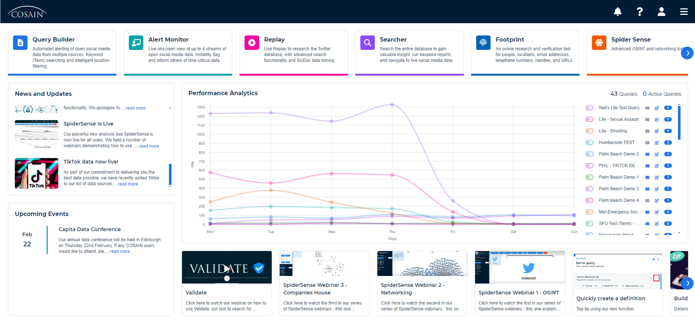
Homepage
COSAIN© is a fully featured and easy to navigate platform, and the homepage is your gateway to all the functions.
Containing the function launch, performance graph UI, news, updates, and embedded training videos, the homepage is where it all starts.

Slide 10
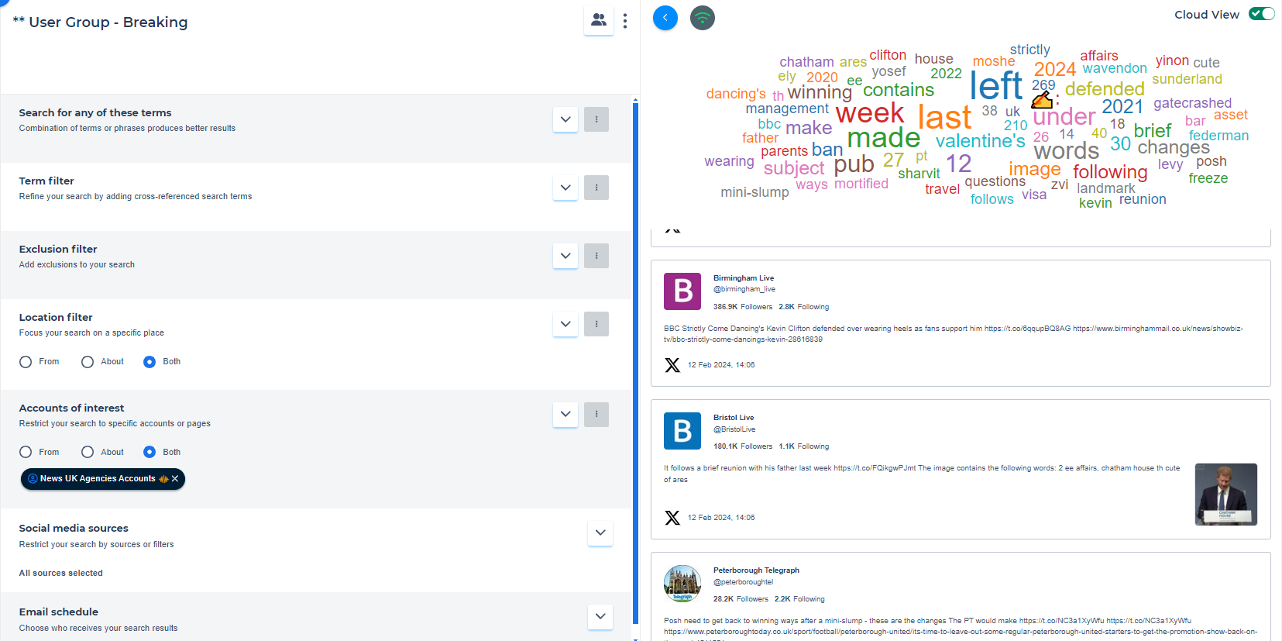
Query Builder
Manual searching of social media is time consuming and inefficient.
Query Builder© is our powerful social media listening platform that automates the data collection process from multiple premium social media sources.
The data is available live onscreen or in scheduled email reports, and there is an instant click-through to the data online.

Slide 11
Query Builder
Search Terms
Query Builder© uses Boolean logic for search terms, and visual indicators to show how noisy a search term is likely to be. Users can share search terms with their team, saving time, and reducing inefficient repetition. Query Builder© reduces noise from results using proprietary exclusion technology.
Translation
Query Builder© translates multiple languages into English and will show both the original and translated text in your results.
Definitions
Search terms can be grouped together into search lists called Definitions©, which are used as building blocks to create complex queries with minimal effort.
Definitions© can be shared with other team members for added efficiency.
Geofences
Any location being searched is assigned a geofence and COSAIN© searches for mentions/indications of a location in multiple clever ways to ensure you get the most geographically relevant insight.
Noise Exclusion
COSAIN© has easy to use proprietary technology that is specifically designed to reduce noise and aid deduplication in the data reports. COSAIN© can remove any posts from your results that contain certain text and location-based exclusions.
Optical Character Reading (OCR)
COSAIN© recognises when a social media post has an image attached and will read it to determine if there is any text written inside the image, then display the OCR’ed text in your results.

Slide 12





Viewing Collected Data
1. Live onscreen
View near-live time data onscreen, with instant click-through to the data online. Users can also flag and forward individual posts for immediate action.
2. Email Reports
Scheduled email reports, from near-instantaneous to 24-hours, or any time in between. You can send the reports in PDF/Excel/CSV/HTML to any interested party in your organisation.
3. In-app reporting
Can’t wait for email reports to arrive by email? View them inside COSAIN and you can additionally select relevant posts for instant download or onward transfer to a colleague.
4. Dashboards
Are you used to dealing with large amounts of data and visualising it in i2 Analyst’s Notebook. In early 2025 we are releasing our new i2 API to allow you to do just that with COSAIN data.
5. API delivery
Are you used to dealing with large amounts of data and visualising it in i2 Analyst’s Notebook. In early 2025 we are releasing our new i2 API to allow you to do just that with COSAIN data.

Slide 13
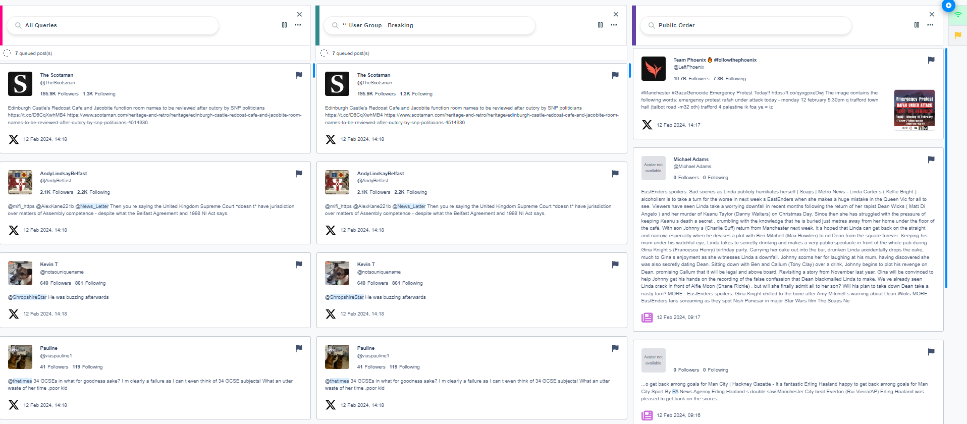
Alert Monitor/
Lite/DataViewer licences
Want to see live data from more than one query at a time?
Alert Monitor© allows users to view live data from multiple queries, with instant click-through to the data online. Users can also flag and forward individual posts for immediate action.
Want to share the live data results with others? Lite/DataViewer© licences are based on the Alert Monitor function and have a simple UI which requires minimal training. You get free Lite/DataViewer licences with Standard licences.

Slide 14
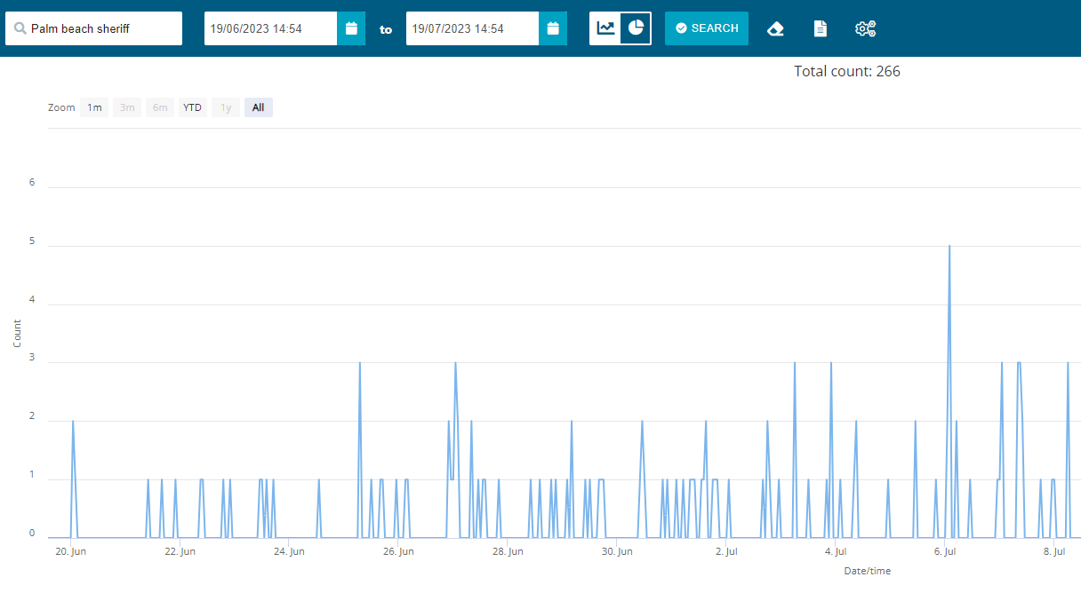
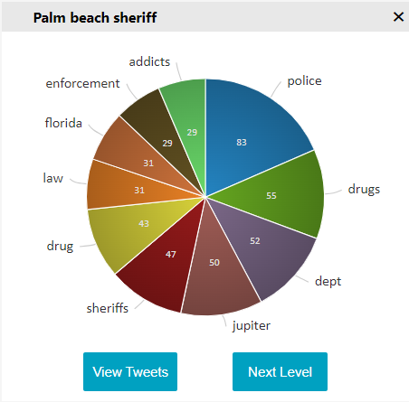
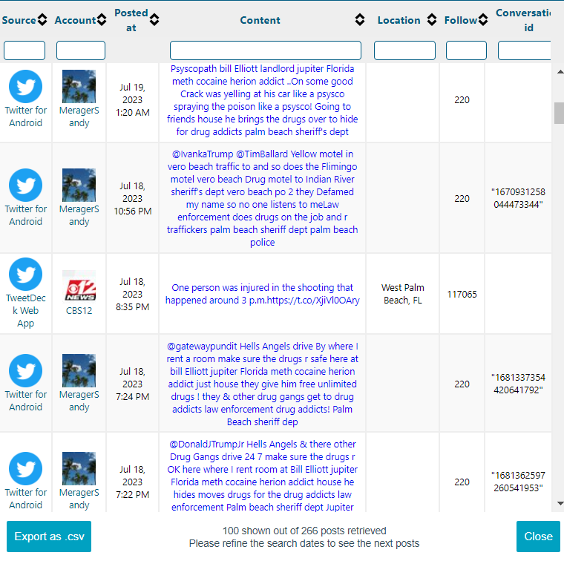
Replay Twitter
Search
Interested in historical research on X (Twitter)?
Replay© allows users to search X’s Full Archive database all the way back to the start of Twitter in 2006 and has multiple display options, with instant click-through to the data online, and a geotagged map search function.
Is deep analysis your preference? Replay© can help you find previously unknown insight by mining the data to multiple levels using our bespoke SixDos© function.

Slide 15
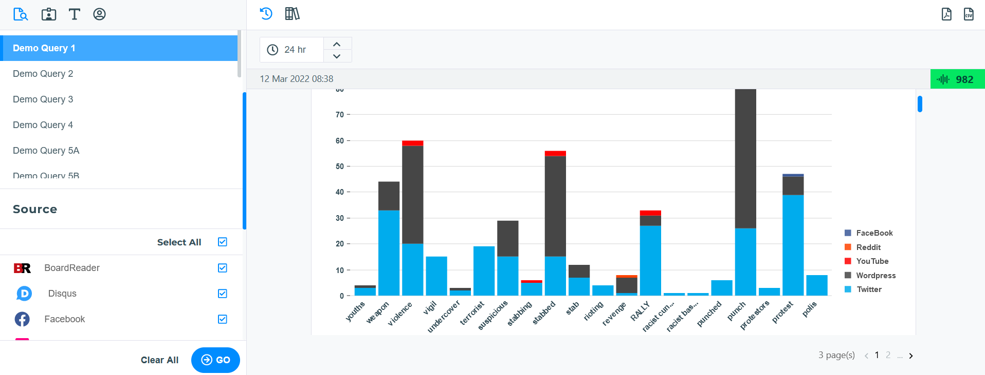
Searcher
Concerned you may have missed something important? Users can interrogate COSAIN’s vast data-lake for previously unknown insight and export it for analysis or instant click-through to the data online. Searcher© has several granular search options to help you locate any missing insight.

Slide 16
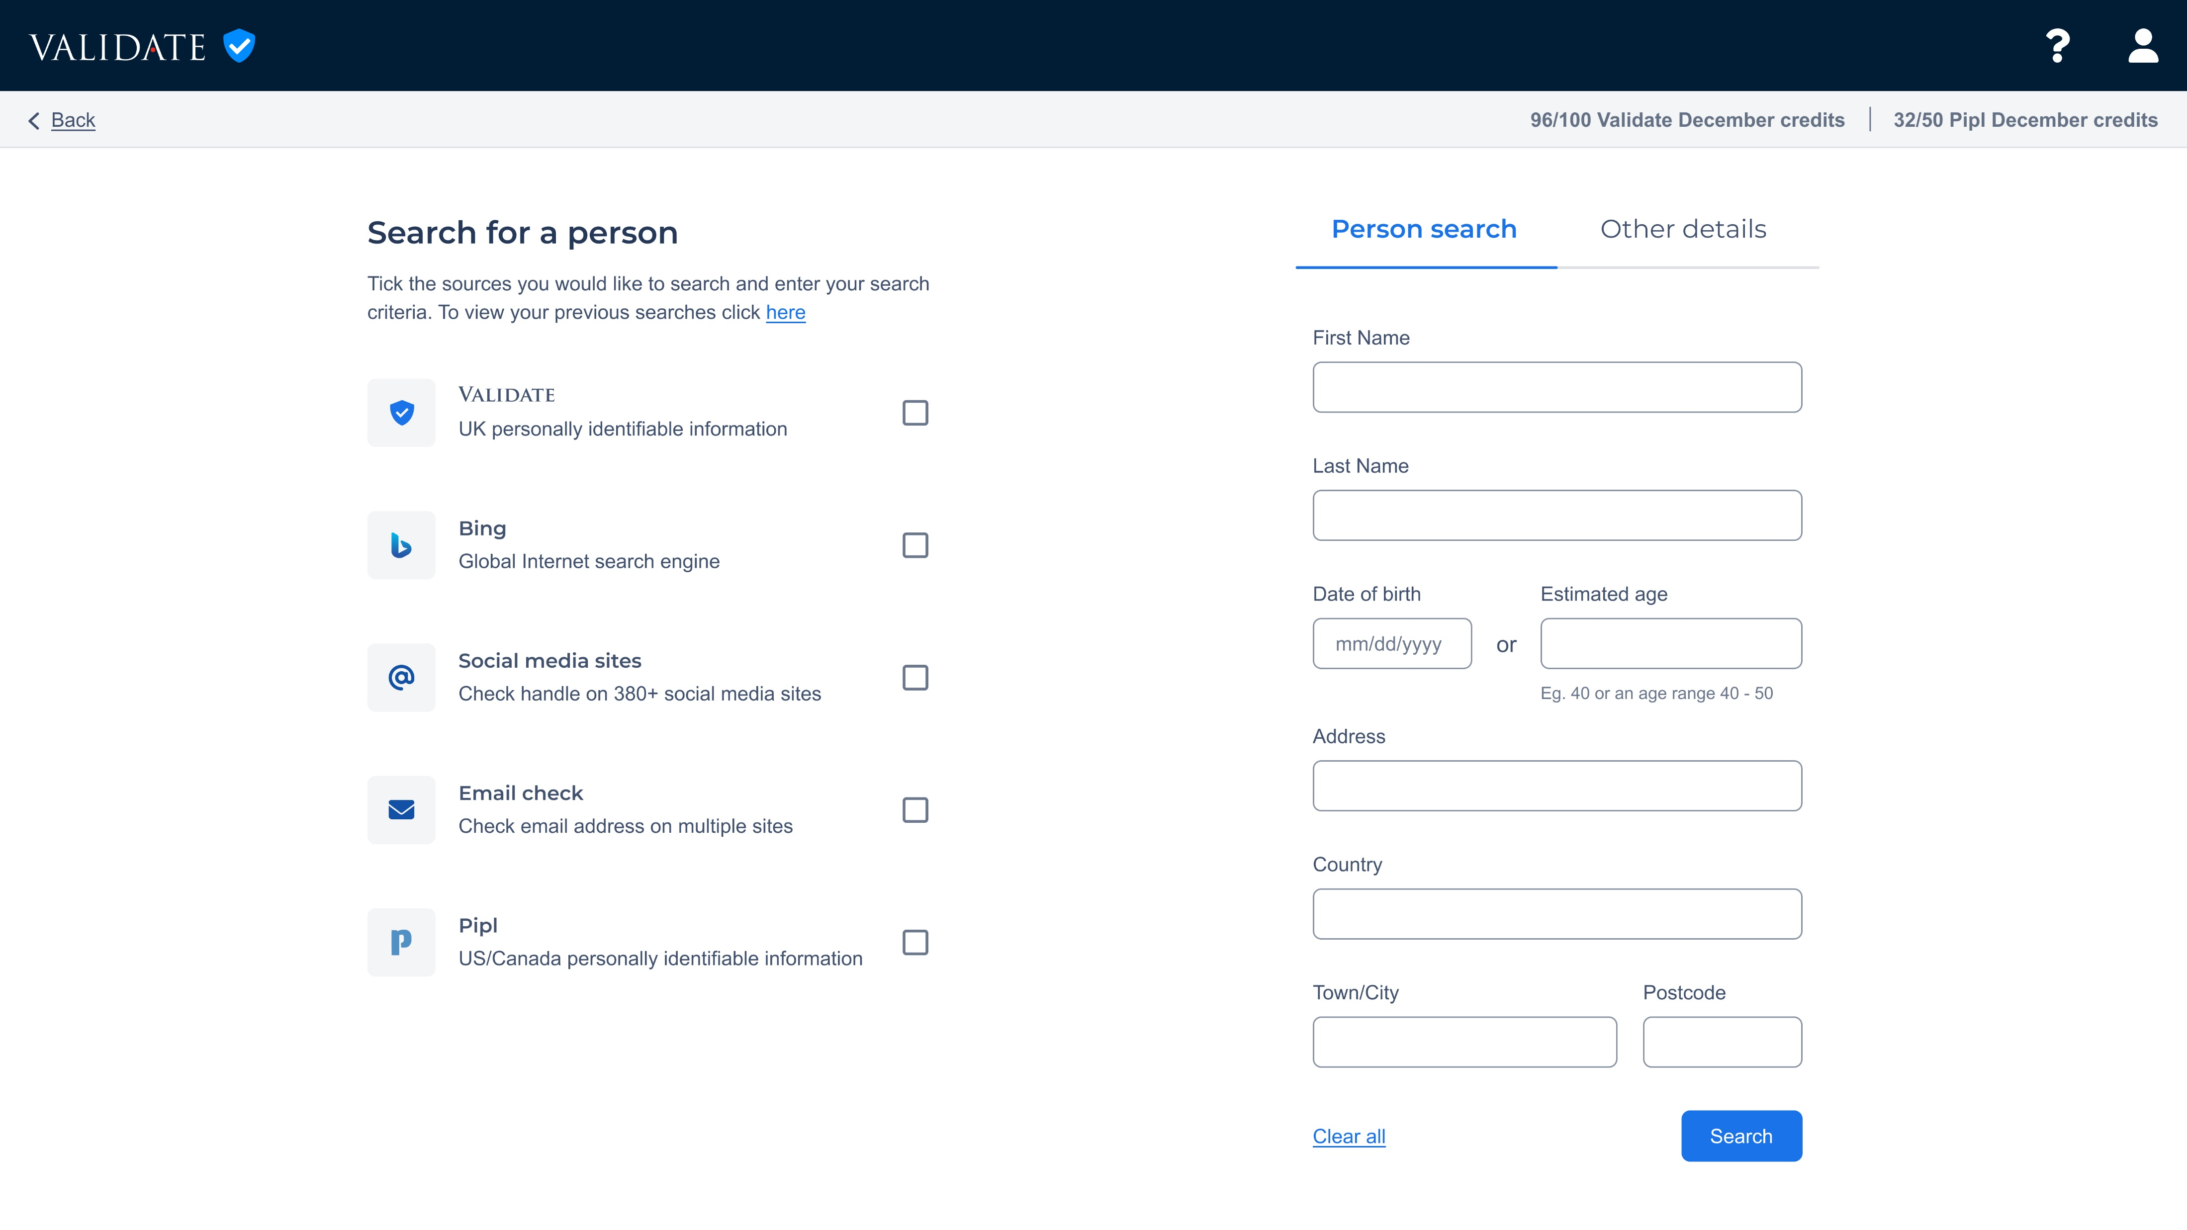

Footprint
50/50
Need help to find people or validate personal data?
Footprint© is an online tracing and data verification tool, with an intuitive UI.
You get a generous allowance of free Validate© consented data searches per month, which gives users access to both publicly available and ethically collected non-publicly available personally identifiable information.
A higher Validate credit limit can be easily arranged. POA.

Slide 17
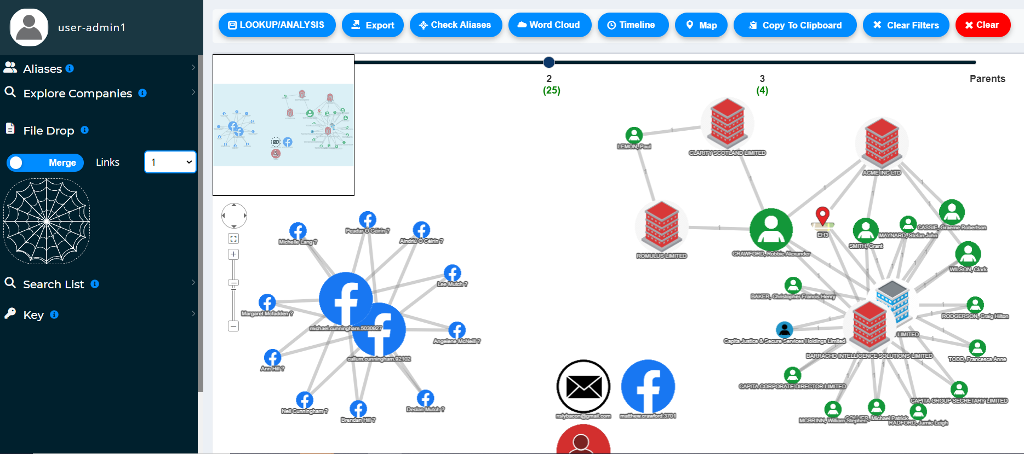
SpiderSense
Do your staff find it hard to navigate large or multiple data sets? SpiderSense provides users with multiple options to visualise data sets onscreen and discover previously unknown networks. SpiderSense is also a powerful OSINT tool, with breached data insight and an advanced UK Company House search, perfect for financial investigators.

Slide 18
COSAIN Pricing
COSAIN© is available on the G Cloud Digital Marketplace and offers a low-cost entry point of £19,495 to the most mature multi-user Social Media Listening and OSINT platform available in the UK. Discounts are available for multiple licenses and there are free DataViewer© licences for a distributed capability within your organisation.
There are no setup fees and customers do not require any specialist equipment to access COSAIN©, just an internet connection. There are no hidden costs, and free trials are available.
If you don’t have a dedicated i3/OSINT/research team, COSAIN© can also be offered as a managed Bureau service, and our in-house subject matter experts will gather online insights on your behalf. Please contact us to get more information about the managed bureau service.
1 Licence
2 Licences
3+ Licences
1 Licence
£19,495
1 Licence
£18,895 per licence
1 Licence
£18,445 per licence
A discretionary discount may be available for purchase of 15 licences or more, please contact the COSAIN team for further details.
All prices are ex-VAT.

Slide 19
Contact us
Email: COSAIN.support@capita.com

